Slide 1

The New Civil Procedure Rules (CPR) 2022
Parts 29-33 and 35-41
The Honourable Madame Justice Camille Darville Gomez
Meryl Glinton
April 6, 2022

Slide 2
Part 29 - EVIDENCE
See: Rules of the Supreme Court - RSC
Orders 27, 31A, 38, 41
Addresses evidence given at trial or hearing CPR 29.2
general rule (i) At trial give oral evidence; (ii) at any other hearing by affidavit
Mode of giving evidence CPR 29.3
  evidence given via video link
Defines and sets out form of witness statements - CPR 29.5
Introduces and defines witness summaries - CPR 29.6

Slide 3
CPR 29.5 and 29.6 - Observations on Witness Statements/Summaries
Must be filed? – CPR 29.4(4)(b) NEW!!
Form similar to existing format used – note that RSC does not address the format

Slide 4
NEW - CPR 29 .7
Procedure where one party will not serve witness statement as directed
WHAT TO DO?
Party in compliance
file statements in a sealed envelope and
give notice to the defaulting party.
Defaulting party
File and serve statements on the other party
Provide Affidavit of Service/Certificate evidencing service
Court
(i) DO NOT DISCLOSE statements to the defaulting party UNTIL they have certified service of their own

Slide 5
OBSERVATIONS OF CPR 29 .7
Court must determine practice and procedure of acceptance of sealed envelopes.
  (i) who is to provide the envelopes, specifics of size, colour etc
  (ii) information to be placed on the envelope – name of parties, to the action, file number, law firm?
  (iii)Form of Notice to the defaulting party – need to be addressed
  (iv) Certificate or Affidavit of Service – how does the defaulting party certify service?
  (v) How will this procedure be addressed when E-filing is introduced?
Perhaps by Practice Direction?

Slide 6
CODIFICATION OF EXISTING PRACTICE – CPR 29.8 AND 29.9
CPR 29.8 – witness must be called where witness statement or summary served and the evidence is being relied upon; if a witness statement or summary is served but party does not intend to call that witness at trial must give not less than 28 days notice before trial.
CPR 29.9 – amplification of evidence with permission of the court

Slide 7
CODIFICATION OF EXISTING PRACTICE – CPR 29.10 - 29.11
CPR 29.10- Witness called at trial may be cross examined on statement/summary whether or not addressed in exam-in-chief
CPR 29.11- if statement/summary not served within specified time by Court, the witness may not be called unless Court permits. Court may not give permission at the trial unless good reason for seeking relief under CPR 26.8 (relief from sanctions)

Slide 8
EXTENSION OF TIME FOR SERVICE OF WITNESS STATEMENTS – CASE LAW
Where a party fails to serve witness statements on time, the court will usually extend time for service and will only in very extreme circumstances use its powers to exclude that party from adducing evidence at trial; such circumstances may include the deliberate flouting of court orders or inexcusable delay such that the only way that the court could fairly entertain the evidence would be by adjourning the trial. The Caribbean Civil Court Practice

Slide 9
CODIFICATION OF EXISTING PRACTICE – CPR 29.12
CPR 29.12 – statements used only for the purpose of the proceedings in which served unless Court gives permission for some other use, the witness consents in writing, statement has been put into evidence.

Slide 10
Part 30 – AFFIDAVITS
Compare with RSC Orders:
31A r.3.18, 32 r.7, 39 r.1 and 4,41 r. 1, r. 5, r.6, r.7, r. 8, r.9, r.10
CPR 30.1 (i) application may be made for the attendance of the deponent to be cross-examined.
- 21 days before trial;
- 7 days before any other hearing
(ii) Affidavit may not be used if the deponent fails to attend.

Slide 11
CPR 30.2 AND 30.3 - NEW
CPR 30.2 – Affidavit must be in a specific form in particular – top right hand corner and back sheet must contain: (i) name of party on whose behalf filed,(ii) initials and surname of the deponent, (iii) where he has multiple affidavits, the number of the affidavit, (iv) the identifying reference of each exhibit referred to in the affidavit, (v) the date sworn, and (vi) the date filed.
CPR 30.3 – Alterations must be initialed by both the deponent and the person before whom it was sworn.

Slide 12
CPR 30.4 and 30.5 – NEW
(3) CPR 30.4 – If more than one document to be exhibited it may be included in a paginated bundle arranged chronologically or in some other convenient manner and labelled in accordance with CPR 30.2. (an Affidavit containing only exhibits?)
(4)CPR 30.5:
must contain full name, address and qualifications of person before whom sworn/affirmed.
Statement of authentication must follow immediately from text and not be on a separate page.
Presumption that affidavit sworn or affirmed in accordance with foreign law and procedure.

Slide 13
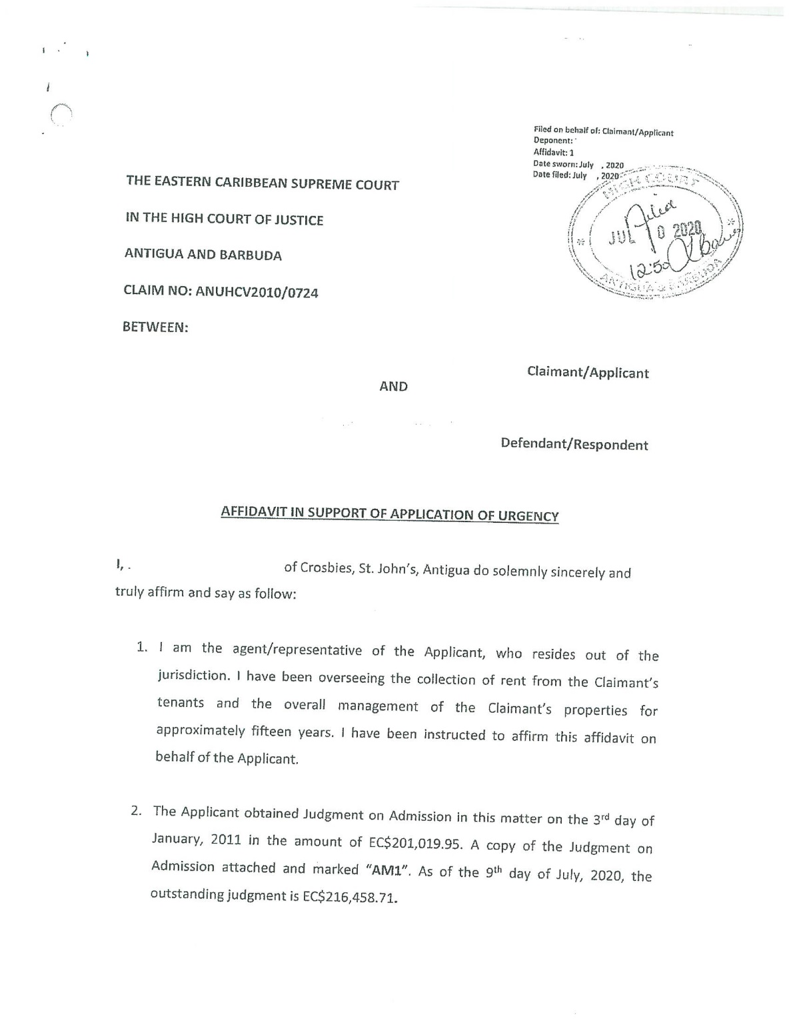

Slide 14
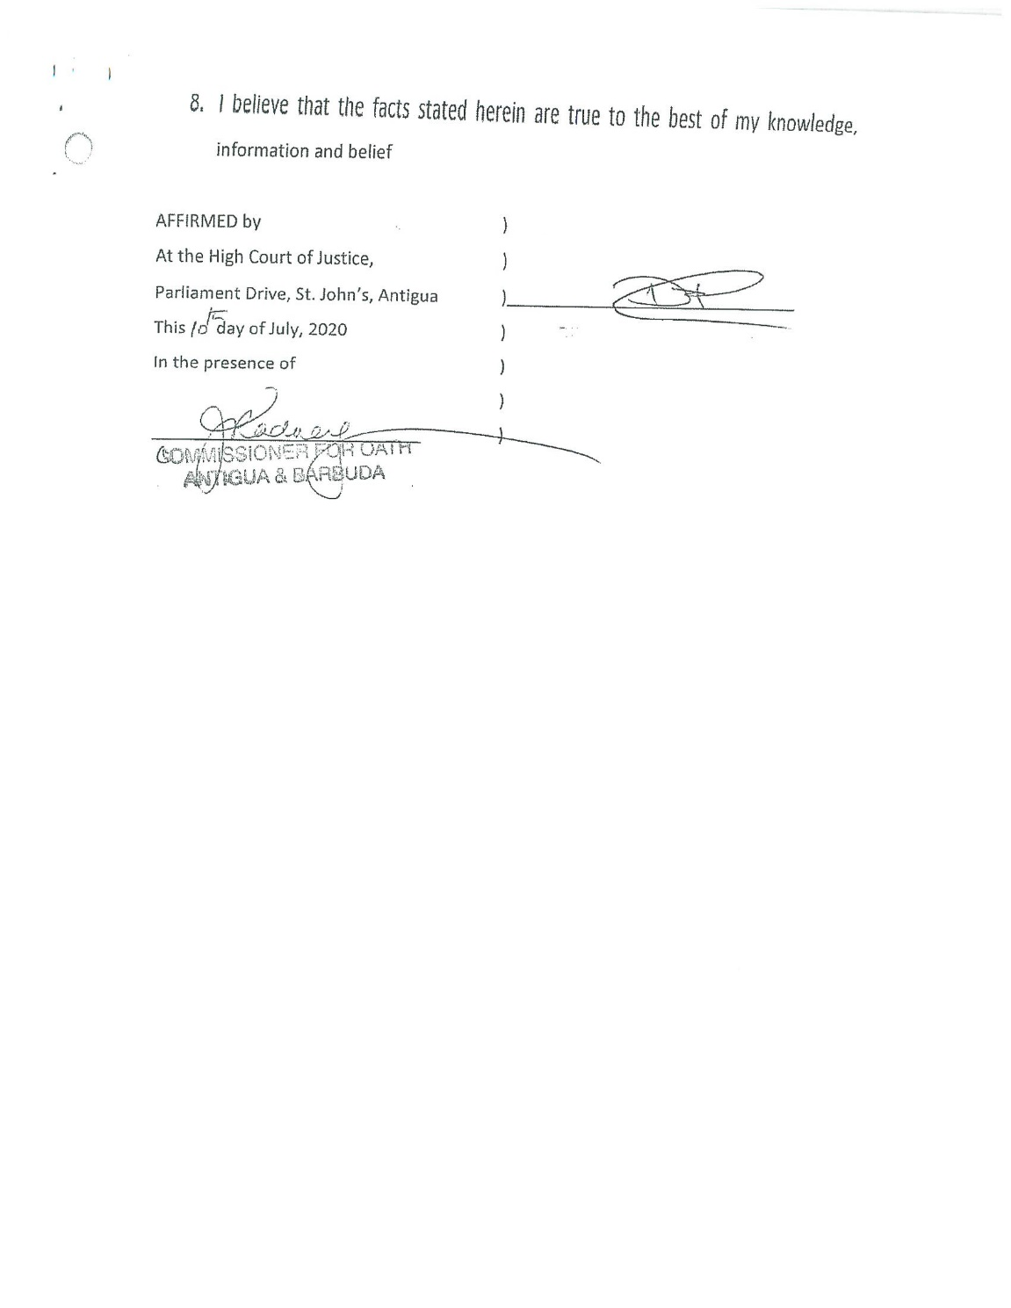

Slide 15
Part 31.1 – Miscellaneous Rules about Evidence
Refer to Orders 38, 39 and 40
Use of plans, photographs etc. as evidence
Must disclose intention to rely on any evidence which is not to be given orally and contained in a witness statement, affidavit or expert report. Failure to disclose means that the evidence will not be given.
Disclosure by the latest date for serving witness statements – evidence may not be given if there is failure to disclose

Slide 16
CPR 31.2 EVIDENCE ON QUESTIONS OF FOREIGN LAW NEW
A party intending to adduce evidence on foreign law must first give notice to every other party of that intention.
no less than 42 days before the hearing
Notice to attach the document which forms the basis of the evidence
specify the question on which the evidence is to be adduced

Slide 17
Part 32 – Experts and Assessors
Refer to RSC Orders 38(33), 38(42) and 40
Definition of expert witness CPR 32.1
Expert evidence must be restricted to which is reasonably required to justly resolve proceedings CPR 32.2
Experts duty to help the court impartially – overrides any obligation to the person by whom instructed or paid CPR 32.3
Duty of the expert and ingredients of the report CPR 32.4
Expert may apply in writing for directions – CPR 32.5

Slide 18
WHAT’S NEW?
CPR 32.6 – must name the expert witness and identify the nature of the expertise – permission granted for named expert only
CPR 32.8 – a party may put written questions to a joint expert or to the other party’s expert about their report
- questions put in once and MUST be put within 28 days of service of the report
3) CPR 32.9 – court’s power to direct evidence by a single expert
4) CPR 32.10 – an expert may be cross-examined by any party

Slide 19
WHAT’S NEW - CONTINUED
5) CPR 32.11 – Instructions may be given by each instructing party where there is a single expert.
-instructions given must be shared by the other party
6) CPR 32.12 – if a party has access to information not reasonably available to the other party, the court may order that party (i) to arrange for an expert to prepare a report on any matter; (ii) if appropriate to arrange for examination to be carried out in relation to that matter; and (iii) to file the report and serve a copy on any other party. This power only exercisable upon application by a party. BEWARE

Slide 20
WHAT’S NEW CONTINUED
7) CPR 32.13 – Expert’s report to be addressed to the court and not to the instructing party
8) CPR 32.14 – Contents of the expert report set out
9) CPR 32.15 – the court may direct a meeting of experts of like specialty and may specify the issues for discussion (which is to remain confidential, unless the parties agree otherwise). After meeting the experts must prepare a statement of any issue on which either agree or disagree with reasons. Additionally, the court may direct that they prepare an agreed statement of the basic “science” applicable to matters relevant to their expertise.

Slide 21
Part 33 – Court Attendance by witnesses and depositions
Refer to RSC Orders 38, 39 and 40
This part provides for a party to obtain evidence prior to a hearing (includes a trial) and for circumstances where a person may be required to attend court to give evidence or produce a document

Slide 22
NEW PROVISIONS IN CPR 33
1) CPR 33.2 - New terminology now called Witness summons – issued by the court compelling a witness to attend court or give evidence or produce a document.
Each witness must have a separate summons
2)CPR 33.4 – the Court may issue a witness summons in aid of any court or tribunal which does not have power to issue one in relation to proceedings before it
3) CPR 33.5 – general rule is that a witness summons is binding only if served at least 14 days before the witness is required to attend unless the court otherwise directs.

Slide 23
NEW PROVISIONS CONTINUED
4) CPR 33.6 – at the time of service of the witness summons the witness must be offered or paid a reasonably sufficient sum to cover subsistence and travel expenses to and from court. To be specified in a Practice Direction.
5) CPR 33.7 – travel expenses must be offered at the time of service of the order. Conduct money?

Slide 24
Part 35 – Offers to settle
There is no equivalent in RSC
Similar to the CPR in the United Kingdom – Part 36 Offer but not identical

Slide 25
CPR 35.1- Scope of this Part
This Part contains Rules about –
offers to settle which a party may make to another party; and
the consequences of such offers.
(2) This Part does not limit a party’s right to make an offer to settle otherwise than in accordance with this Part.
(3) The Rules in this Part are subject to rule 23.12 (compromise, etc. on behalf of a minor or patient).
Part 36 deals with payments into court.

Slide 26
CPR 35.2- Introductory
An offer can be made in any proceedings, whether or not the claim is for money.
Definition of terms
  “Offerer”
  “Offeree”
  Offer is “made” when it is served on the Offeree.

Slide 27
CPR 35.3- Making Offer to Settle
(1) A party may make an offer to another party which is expressed to be “without prejudice” and in which the offeror reserves the right to make the terms of the offer known to the court after judgment is given with regard to –
  (a) the allocation of the costs of the proceedings; and
  (b) (in the case of an offer by the claimant) the question of interest on damages.
(2) The offer may relate to the whole of the proceedings or to part of them or to any issue that arises in them.

Slide 28
CPR 35.4 and 35.5- Time and Procedure for Making an Offer
35.4
  A party may make an offer to settle under this Part at any time before the beginning of the trial.
35.5
  (1) An offer to settle must be in writing.
  (2) The offeror must serve the offer on the offeree and a copy on all other parties.
  (3) Neither the fact nor the amount of the offer or any payment into court in support of the offer must be communicated to the court before all questions of liability and the amount of money to be awarded (other than costs and interest) have been decided.
  (4) Paragraph (3) does not apply to an offer which has been accepted or where a defence of tender before claim has been pleaded.

Slide 29
CPR 35.6, 35.7, and 35.8- What an Offer Must Include
Rule 35.6- An offer to settle a claim for damages MUST state whether the figure offered includes costs and/or interest, and if so, how much is apportioned to each.
If there is a counterclaim, any offer made MUST state
  Claimant Offerer- whether the offer takes into account the counterclaim
  Defendant Offerer- whether the offer takes account of the claim.
Rule 35.7- If an interim Payment has been made, any subsequent offer MUST address whether the offer is in addition to or intending to replace the interim payment.

Slide 30
CPR 35.6, 35.7, and 35.8- What an Offer Must Include
Rule 35.8
An offer to settle must state whether or not it covers the whole or part of the claim.
If it does not state that it covers part of the claim, it is to be taken to cover the whole claim. (Emphasis Added.)
If the offer covers only part or parts of the claim it must –
identify the part or parts of the claim in respect of which it is made; and
if more than one, state what is offered in respect of each part covered by the offer.

Slide 31
CPR 35.9- Timeline for Accepting an Offer
(1) The offeror may state in the offer that it is open for acceptance until a specified date.
(2) The offer shall have no effect on any decision that the court makes as to the consequences of the offer unless it is made at least 22 days prior to the commencement of the trial and that it is open for acceptance for at least 21 days.
(3) Acceptance of the offer after the commencement of the trial shall have no effect on any decision that the court makes as to the consequences of such acceptance.
(4) The court may permit an offeree to accept an offer after the specified date on such terms as the court considers just.

Slide 32
CPR 35.10- Procedure for Accepting an Offer
(1) To accept an offer a party must –
serve written notice of acceptance on the offeror; and
(b) send a copy of the notice to any other party.
(2) The offeree accepts the offer when notice of acceptance is served on the offeror.
(3) If an offer or payment into court under Part 36 is made in proceedings to which rule 23.12 applies –
the offer or payment may be accepted only with the permission of the court; and
no payment out of any sum paid into court may be made without a court order.
Rule 23.12 deals with compromises, etc. by or on behalf of a minor or patient.

Slide 33
CPR 35.11- Effect of Acceptance (generally)
(1) If the offeree accepts an offer which is not limited in accordance with rule 35.8, the claim is stayed upon the terms of the offer.
(2) If the offer covers a claim and a counterclaim, both the claim and the counterclaim are stayed on the terms of the offer.
(3) In any other case, the proceedings are stayed to the extent that they are covered by the terms of the offer.
(4) If the court’s approval is required for the settlement of the proceedings, any stay arising on the acceptance of the offer has effect only when the court gives its approval.
Rule 23.12 deals with the settlement of proceedings Involving minors and patients.
(5) A stay arising on the acceptance of an offer does not affect proceedings to deal with any question of interest on damages or any question of costs relating to the proceedings which have been stayed and which have not been dealt with by the offer.
(6) If money has been paid into court in support of an offer, a stay arising out of the acceptance of the offer does not affect any proceedings to obtain payment out of court.
Part 36 deals with payments into court.

Slide 34
CPR 35.11- Effect of Acceptance (generally)
(7) If an offer is accepted and its terms are not complied with, any stay arising on acceptance ceases to have effect and –
the proceedings or the part which was stayed may continue; and
either party may apply to the court to enforce those terms.
(8) If a party claims damages for breach of contract arising from an alleged failure of another party to carry out the terms of an agreed offer, that party may do so by applying to the court without the need to commence new proceedings unless the court orders otherwise.

Slide 35
CPR 35.12- Effect of Acceptance (more than 2 parties)
(1) If there is more than one defendant whom the claimant claims are jointly and severally, or severally, liable and the claimant –
agrees to settle the claim as against one or more, but not all of them; and
discontinues the claim against any other defendant;
the claimant is liable to pay the costs of the defendant against whom the claim has been discontinued unless the court otherwise orders.
Part 37 deals with discontinuance.

Slide 36
CPR 35.12- Effect of Acceptance (more than 2 parties)
(2) If a claimant accepts an offer made by one of a number of joint defendants –
paragraph (1) does not apply; and
the defendant who made the offer is liable for the costs of the other joint defendants.
(3) If–
there is more than one claimant; and
one or more, but not all, of them agree to settle;
the other claimants may continue the proceedings.

Slide 37
CPR 35.13- Costs where a Defendant’s offer is accepted
(1) If the –
(a) defendant makes an offer to settle; and
(b) claimant accepts the offer within any period stated for accepting it and before the beginning of the trial;
the claimant is entitled to the costs of the proceedings up to the date of acceptance of the offer.
(2) If the defendant permits a claimant to accept an offer after the time stated for accepting it, the general rule is that the –
claimant is entitled to costs to the end of the period stated for accepting the offer; and
defendant is entitled to any costs incurred between the end of the period stated for accepting the offer and the date when the offeree accepts the offer; unless the court orders otherwise.

Slide 38
CPR 35.13- Costs where a Defendant’s offer is accepted
(3) If the settlement relates only to part of the proceedings and the remaining part or parts of the proceedings continue –
the claimant is entitled under this rule only to the costs relating to that part of the proceedings which has been settled; and
unless the court orders otherwise or the defendant agrees, the claimant may not recover any such costs, nor have them quantified, until the conclusion of the rest of the proceedings, when the court can deal with the costs of the whole of the proceedings including any costs relating to those parts of the proceedings that were not settled.

Slide 39
CPR 35.14- Costs where a Claimant’s offer is accepted
If the claimant makes an offer which is accepted by the defendant, the claimant is entitled to costs up to the time when notice of acceptance of the offer is served.

Slide 40
CPR 35.15- Costs where Offer not Accepted
Rule 35.15 sets out the general rules and exceptions
Rule 35.15(1) – Where Claimant does not accept a Defendant’s offer
Rule 35.15(2) – Where a Defendant does not accept a Claimant’s offer
Rule 35.15(3) and (4)- Exceptional Circumstances

Slide 41
CPR 35.15(1) – Where Claimant does not accept a Defendant’s offer
The general rule for defendants’ offers is that, if the defendant makes an offer to settle which is not accepted and in –
the case of an offer to settle a claim for damages – the court awards less than 90% of the amount of the defendant’s offer;
any other case – the court considers that the claimant acted unreasonably in not accepting the defendant’s offer;
the claimant must pay any assessed costs incurred by the defendant after the latest date on which the offer could have been accepted without the court’s permission.

Slide 42
CPR 35.15(2) – Where a Defendant does not accept a Claimant’s offer
(2) If a claimant makes an offer to settle and in –
the case of an offer to settle a claim for damages – the court awards an amount which is equal to or more than the amount of the offer;
any other case – the court considers that the defendant acted unreasonably in not accepting the claimant’s offer;
the court may, in exercising its discretion as to interest take into account the rates set out in the following table:

Slide 43
CPR 35.15(2)- Interest Consequences
Net amount of damages ‘net’= the amount of damages on the claim less the amount (if any) awarded on any counterclaim. | Rate of Interest
not exceeding B$100,000 | 12% per annum.
for the next B$150,000 | 10% per annum
for the next B$500,000 | 9% per annum
in excess of B$800,000 | 7% per annum

Slide 44
CPR 3.15(2)- Example
One year since the offer.
Damages – B$400,000;
The court might award –
12% on the first $100,000 for one year ($12,000);
plus 10% interest on the next $150,000 for one year ($15,000);
plus 9% interest on the remaining $150,000 for one year ($13,500);
=a total of B$40,500 interest on damages.

Slide 45
CPR 35.15(3) and (4)- Exceptional Circumstances
(3) The court may decide that the general rule under paragraph (1) is not to apply in a particular case.
(4) In deciding whether the rule in (1) above should not apply and in considering the exercise of its discretion the court may take into account the–
conduct of the offeror and the offeree with regard to giving or refusing information for the purposes of enabling the offer to be made or evaluated;
information available to the offeror and the offeree at the time that the offer was made;
stage in the proceedings at which the offer was made; and
terms of any offer.

Slide 46
Rule 35.15(5)- When does it apply?
This rule applies to offers to settle at any time, including before proceedings were started.

Slide 47
CPR 35.16- How Costs Are To Be Dealt With
If an offer to settle is accepted, the parties may agree the amount of costs that are due to be paid under this Part.
If an offer to settle –
is accepted after the time originally stated for accepting it under rule 35.10(2); or
deals only with part of the case in accordance with rule 35.13(3);
the amount of costs to be paid to the party entitled to such costs must be assessed by the court.

Slide 48
Part 36-Payments into Court to Support Offers under Part 35 and under Court Order
Some similarities to R.S.C. Order 22
Whereas R.S.C. Ord. 22 addresses only court orders and defences of tender, this Part also addresses payments into Court to support an Offer under CPR Part 35.
To the extent that CPR Part 35 addresses right to obtain funds paid into Court, some of R.S.C. Ord. 22 already covered there.

Slide 49
CPR 36.1- Scope of this Part
(1) This Part deals with payments into court made –
in accordance with an order of court;
to support a defence of tender; and
to support an offer of payment under Part 35.
(2) A defendant is not obliged to make a payment into court to support an offer under Part 35.

Slide 50
CPR 36.1- Scope of this Part
(3) With the –
agreement of the claimant; or
permission of the court;
a defendant may pay money in support of an offer of payment into an interest bearing account on such terms as to the –
names of the account holders; and
terms on which money may be paid out of the account as may be ordered by the court or agreed between the parties.

Slide 51
CPR 36.2- Payment into Court to Support Offers to Settle
A defendant who offers to settle the whole or part of a claim may pay money into court in support of the offer.
(2) A defendant may not pay money into court unless the –
defendant certifies that such payment is in support of an offer to settle;
payment is made to support a defence of tender; or
payment is made under a court order.
(3) A payment into court may not be made until a claim is filed.

Slide 52
CPR 36.2- Payment into Court to Support Offers to Settle
(4) A payment into court to support an offer may be made –
when the offer is made; or
at any time while the offer is outstanding.
(5) A defendant who pays money into court must –
serve notice of payment on the claimant; and –
file a copy of the notice with a statement of the date (if any) by which the offer is open for acceptance under rule 35.9(1).

Slide 53
CPR 36.3- Right to Payment Out on Acceptance of an Offer
The general rule is that a claimant who accepts an offer to settle –
(a) within the period stated; or
(b) where no period is stated;
for accepting it in the defendant’s offer is entitled to payment of the sum which the defendant paid into court to support the offer, without needing a court order.
(2) To obtain payment, the claimant must file a request for payment certifying that the offer has been accepted in accordance with paragraph (1) (a) or (b).
(3) The general rule is qualified by rule 36.4.

Slide 54
CPR 36.4- Exceptions to CPR 36.3
Require a Court Order (which must address costs of any part of the claim stayed) if: - Offer accepted after period indicated for acceptance; - Offer accepted and money paid into Court by one or more but not all Defendants; - Money paid into court to settle a claim to which Part 23 (Claims by minors and patients) or Rule 36.7 (proceedings under Fatal Accidents Act) apply (nor can such orders be consent orders); - Claimant accepting money paid in where a defence of tender was asserted; - If a claimant accepts money paid in after trial has commenced and all proceedings (or part to which acceptance relates) are stayed.

Slide 55
CPR 36.5 – Money Paid Into Court Under Order
Replaces R.S.C Ord. 22 rr. 1(2) and 8
General Rule is that where money paid in under a Court Order, may not be paid out without Court permission.
Carves out an exception where
  Money paid in by a Defendant
  Defendant makes an offer to settle which is accepted by the Claimant
  Rule 36.6 applies

Slide 56
CPR 36.6- Money Paid Into Court as a Condition of Defending
New!
Where money paid in as a condition of defending or continuing the defence, if that Defendant makes an offer to settle may elect to treat those funds as supporting the offer (whether offer was made before or after the Order) by filing a notice of that election and serving it on every other party.

Slide 57
CPR 36.7- Proceedings Under the Fatal Accidents Act
Special requirements apply where claims under the Fatal Accidents Act involved;
Where an offer accepted and a single sum of money is paid into Court
  The Court must apportion the sum amongst the various causes of action; and
  Any sum apportioned to the claim under the act, must also be apportioned between claimants where there are more than 1.

Slide 58
Part 37 - Discontinuance
Refer to R.S.C. Order 21
This part addresses the procedure for discontinuance of whole or part of a claim by the CLAIMANT (CPR 37.1)
Generally may discontinue without permission from the court (CPR 37.2(1)) as against any or all defendants (CPR 37.2(3))
Permission only needed if (CPR 27.2(2)):
An undertaking given by any party;
An injunction has been granted by the Court;
Claimant has received an interim payment (unless paying Def. consents in writing);
Multiple Claimants and not all seeking to discontinue (unless every claimant consents in writing).

Slide 59
CPR 37.3, 37.4 & 37.5- Procedure, Setting Aside and Effect
CPR 37.3- Procedure
  compare with RSC Ord 21 r 3(2)
  Notice must be served on every other party
  Copy of the Notice must be filed certifying: (a) served; (b) attaching necessary consents; (c ) details of the Order, if permission was necessary; (d) specify against whom it has been discontinued if multiple Ds.
CPR 37.4- Setting Aside for Non-Compliance
  If NOD served without requisite consent/permission, the D may apply within 28 days to set it aside.
CPR 37.5- Effect
  Discontinuance takes effect when Notice served on that D, but doesn’t affect proceedings for costs or applications to set aside.

Slide 60
CPR 37.6, 37.7, & 37.8- Costs
CPR 37.6- Unless the parties agree or the Court otherwise Orders, a Claimant who discontinues is liable to the Def. for costs up to the date when Notice served.
- If only part of the claim discontinued, Claimant only liable for costs relating to that part, and costs will be quantified at conclusion of the claim, unless Court otherwise orders.
CPR 37.7- If part of the claim discontinued, Court MUST assess costs of that part when the claim is resolved.
CPR 37.8- Where a claim is discontinued against a Def. who has entered a defence, and the claimant later brings the same or similar claim, Court may stay the subsequent proceedings until cost of discontinued claim paid.

Slide 61
Part 38 – Pre-Trial Review
Refer to Orders 31(A) 27-30
Very little deviation from existing RSC
Note:
To be held shortly before trial if court so orders (CPR 38.1)
Court to consider whether to hold a PTR at every hearing other than trial (CPR 38.2)
Party may apply for PTR at least 60 days before trial date/period (CPR 38.2)
Court office must give each party at least 14 days notice of the PTR (CPR 38.2)
Case Management Rules apply to PTR (CPR 38.3)
Wherever practicable, PTR should be conducted by trial Judge (CPR 38.4)

Slide 62
CPR 38.5 and 38.6
(6) Parties MUST seek to agree a Pre Trial Memorandum, which must be and served not less than 7 days before PTR (where agreed) or each file and serve their own not less than 3 days before trial (where not agreed). (CPR 38.5)
- Sets out what must be included (similar to RSC Ord. 31A r 29)
(7) At the PTR, Judge MUST give directions to ensure fair, expeditious and economic trial of the issues. (CPR 38.6)
- Some considerations listed inder CPR 38.6(2)
- similar to existing practice under the R.S.C Ord. 31A r. 30.

Slide 63
Part 39 – Documents for use at trial
Refer to RSC Order 35
CPR 39.1
  21 days before trial parties inform Claimant of documents they wish to include in the bundle;
  Claimant to prepare a paginated Bundle with an index, including all documents, but separating agreed and not agreed Bundle (“Documents Bundle”);
  10 days before trial, Claimant must file a fuller Bundle including the Documents Bundle;
  If bundle exceeds 100 pages – a core bundle with only the documents the Judge will need to pre-read or which be referred to repeatedly at trial will need to be prepared;
  Where only counterclaim being tried, Claimant refers to Counter-claimant.

Slide 64
CPR 39.2- 39.5
Court may limit cross-examination (CPR 39.2)
With consent of the Judge, parties may file written submissions instead of or in addition to closing speeches. Must be filed 7 days following trial, or some other period fixed by the Judge. (CPR 39.3)
If Court satisfied that notice was served on an absent party, may strike out the claim or continue in their absence. (CPR 39.4)
Court may apply to set aside a judgment or order made in their absence within 14 days of service. Must be supported by evidence. (CPR 39.5)

Slide 65
CPR 39.6 and 39.7
Judge may adjourn a trial BUT may only do so to a fixed date or a date to be fixed by the Court office. (CPR 39.6)
Judge may inspect any place or thing relevant to any issue. (CPR 39.7)

Slide 66
Part 40 – Appointment of referee to inquire and report
Refer to RSC Orders 30, 36, 37 and 40
Rule 40.1- Court may order claim or issue to be tried by referee where
(i) the parties agree;
(ii) the claim requires prolonged examination of documents or scientific or local investigation which cannot conveniently be carried out by the court;
(iii) the matters in dispute are wholly or mainly of account.

Slide 67
CPR 40.2 and 40.3
Court may refer any issue or question of fact to a Referee for inquiry and report (CPR 40.2)
CPR 40.3
  As a General Rule, MUST be appointed at case management.
  Referee must be agreed by the parties, failing which Court will appoint based on a list provided by the parties, or such other manner as it directs.
  Court MUST (i) specify the question/issue; (ii) decide what fees to be paid to the Referee and by whom (INTERIM), but may later order those fees to be paid by another party (FINAL).
  Court may revoke appointment and appoint another referee at any time, on application or of its own motion.

Slide 68
CPR 40.4- Powers and Duties of the referee
Referee has same powers as the Court, save for power to commit for contempt.
Unless Court otherwise Orders, must adopt simplest, least expensive, most expeditious and just means of conducting the reference.
May be in person or via video conference at time and place convenient to the parties.
Where a summoned witness fails to attend, refuses to be sworn/affirm, or refuses to answer any question/ produce any document, referee may sign and file a certificate of such failure/refusal (thereafter, must apply to Court for enforcement).

Slide 69
CPR 40.5 - 40.7- Referee’s Report & Proceedings Against the Crown
Rule 40.5- Report to be made to the Court and copies supplied to each party
- Referee may submit questions to the Court or make a special statement of facts from which the Court may draw inference.
Rule 40.6- upon receiving the report, Court must fix a date to hear the parties, giving 21 days’ notice. After hearing the party, has wide discretionary power to accept, vary, reject the report or remit.
Rule 40.7- In proceedings against the Crown, referee may not be appointed without the consent of the AG.

Slide 70
Part 41 – Accounts and Inquiries
Refer to R.S.C. Order 43
An application can be made in an existing action or where no existing proceedings, by a fixed date statement of claim supported by affidavit evidence. (CPR 41.1)
Also addresses trial of preliminary issue. (CPR 41.2)
Court MUST give directions on how the account or inquiry to be taken. (CPR 41.2)
Unlike in RSC, accounts MUST be served on every other party, unless Court otherwise directs. (CPR 41.3)

