Slide 1
Bahamas CPR Training 2002
An Introduction and Orientation
Transforming Legal Cultures
INAUGRAL Session: 22nd February 2022
Sir Dennis Byron, Consultant, Past CCJ President; Hon Adrian Saunders, President of the CCJ;
Hon Peter Jamadar, Judge of the CCJ and Chair of CAJO

Slide 2
Objectives
In this inaugural session participants will be:
(i) provided with an overview of the new Rules regime focusing on the major cultural and paradigm shifts which are required to successfully implement the CPR.
(ii) exposed to the philosophy underlying the new Rules and the need for fundamental cultural changes if the Rules are to take root and achieve their purpose.

Slide 3

Transforming Legal Cultures
Understanding How the CPR Changes the System
What are we moving away from …
Notes:
Why was the CPR introduced in 2002?
What changes were hoped for?
How was it intended to operate?
Where are we now – in 2021, moving into the future?

Slide 4
Transforming Legal Cultures
Effecting Behavioral Change, Culture Eats Policies and Plans
Reference experience of other jurisdictions…
Notes:
Why was the CPR introduced in 2002?
What changes were hoped for?
How was it intended to operate?
Where are we now – in 2021, moving into the future?

Slide 5
Transforming Legal Cultures
Systems Matter, Discipline is Essential, Consistency and Leadership Counts …
Notes:
Why was the CPR introduced in 2002?
What changes were hoped for?
How was it intended to operate?
Where are we now – in 2021, moving into the future?

Slide 6

Any Thoughts …
Any Questions …

Slide 7
Transforming Legal Cultures
The Overriding Objective
Effective Case/Flow Management
The Judge as Proactive Manager
Each Case is a Project
Setting Performance Standards
Outcomes Really Matter
Timelines & Timeliness are essential
Proportionality, Save Expense, Time, Resources

Slide 8

Any Thoughts …
What’s this about …
Any Questions …

Slide 9
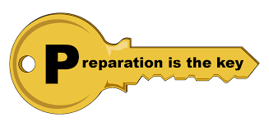
Transforming Legal Cultures
Preparation, Preparation, Preparation …
Front-End Loading
Address, Narrow, Resolve Issues
Explore and Encourage Settlement
Maximize Early disclosure
(Pre-action Protocol PD?)

Slide 10
Transforming Legal Cultures
Preparation, Preparation, Preparation …
Skillful Use of Sanctions
Advance a Case with Every Event/Decision
Event & Trial Date Certainty, Always, ASAP
No Adjournments sine die

Slide 11

Any Thoughts …
Any Questions …

Slide 12
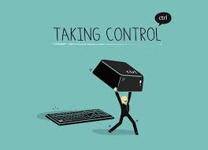
Transforming Legal Cultures
Take Control, Keep Control, Stay in Control
Actively Influence Shape, Timing & Events
Discuss, Settle Costs from Inception
Be Firm, Flexible, and Fair
Involve Parties, People Matter
Respect, Dignity, Equality

Slide 13

Any Thoughts …
Hmmm …
Any Questions …

Slide 14
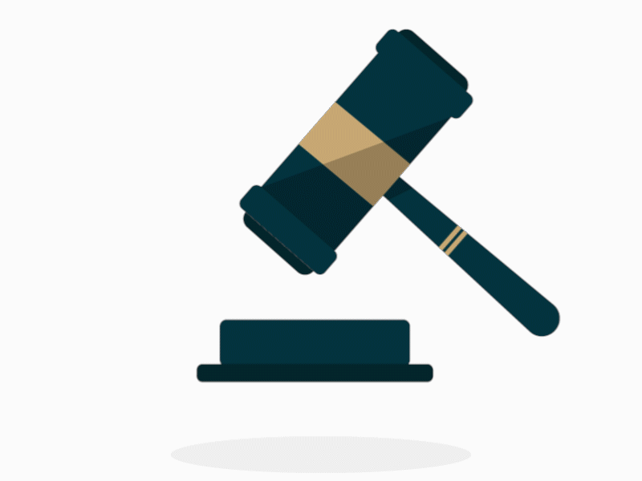
Transforming Legal Cultures
It’s Your Case, Your Court, Your Responsibility
Identify and narrow Issues Early, Push Settlement
Encourage ADR
Set the Shortest Reasonable Timelines Between Events
Zero Tolerance for Delays
Adjournments are Anathema

Slide 15


Slide 16
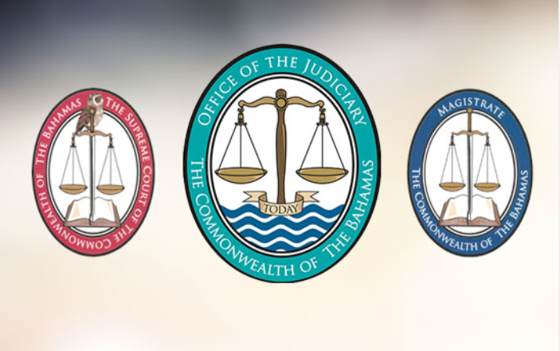
Transforming The legal Landscape:
You Can Make A Difference
These rules will require fundamental changes in the way in which civil proceedings are conducted …

Slide 17

Where do we go from here …
We believe that these rules will represent a significant step forward in the administration of justice in the Commonwealth of The Bahamas …

