Slide 1


Bahamas CPR Training
Commencing Proceedings Evidence Management Witness Statements
Transforming Legal Cultures
Session Three: 16 March 2022
Sir Dennis Byron, Consultant, Past CCJ President
The Hon. Adrian Saunders, President of the CCJ
The Hon. Peter Jamadar, Judge of the CCJ, Chair of CAJO

Slide 2
Commencing Proceedings

Slide 3

By the end of the session the participants will -
Relate the commencement of proceedings to:
  the overriding objective,
  the duty of litigants to assist the court, and
  the powers of the court in ensuring the just and proportionate disposition of disputes
Learn about the three methods of commencing proceedings
Understand the application of measurable performance standards to the management of the commencement of proceedings.

Slide 4

Onus on Litigant for Appropriate Commencement Method
Standard Claim Form:[8.1(5)] For resolution of the majority of disputes
Fixed Date Claim Form [8.1(6)] For resolution of specified case types with low percentage of contested facts resulting in shorter time to disposition
    Hire-purchase and credit sales
    Money lending
    Possession of land
Originating Application Claim Form [8.15/8.16] For resolution of matters not involving substantial dispute of fact or sole purpose of getting approval of settlements involving children and protected party/patient resulting in very short time to disposition.

Slide 5
Court response to error in commencing proceedings (just and proportionate)
Fixed Date Claim Forms
  Court can exercise Case management powers at 1st Hearing [27.2(2)]. Court unlikely to strike out if defendant was not misled Hannigan v Hannigan[2000] 2 FCR 650, CA: option to direct modification of form or to give directions for continuation of proceedings. Court can protect other side by adverse order in costs where appropriate
Original Application Claim Forms
[8.19(1)] Court may with or without application order claim to continue as if Standard Form Claim
[8.27] Party may object to use of OA procedure on grounds
i) there is substantial question of fact; or
ii) procedure is not required or permitted
Court has power to give directions for future management of the case

Slide 6
Limitation of Actions and Time for Service
[8.2] if limitation period is about to expire and claimant received legal advice for first time with 28 days court may allow Claim to be filed without statement of claim under provisions relating to urgency.
[8.14) For the purpose of any enactment relating to limitation periods, an action is brought when it is stamped ( manually or electronically) as received in by or on behalf of the court office see Barnes v St Helens Metropolitan Borough Council [2006] EWCA Civ 1372)
[8.12] General rule is that claim form must be served within 6 months of being issued
[8.13] claimant may apply for extension of period for service: within the period specified by the rule or order of Court: court may grant extension for no more than 6 months on any application, if satisfied that claimant has taken all reasonable steps to serve the form and there is some special reason to extend the form. But the court cannot extend more than once unless satisfied that the defendant is deliberately evading service or there is some other compelling reason

Slide 7
Bringing more than one claim in a claim form
[8.4] single claim form can include all claims which can conveniently be tried together. Important consideration to avoid future difficulty if claim is brought for matters could have been included. [26.3(1)(c ) Recall power to strike out for abuse of process which includes re-litigation of matters which have already or could have been adjudicated by the Court. See Arthur JS Hall c Simons, et al [2000]3All ER673At 701 per Lod Hoffman: and Hunter v Chief Constable of West Midlands [1982]AC 529 (said to be leading case).
[8.5] whereas claimant required to make persons jointly entitled to remedy a party to proceedings, failure to add necessary party or adding unnecessary party will not usually result in claim failing.

Slide 8
General Duty to Set out Case
[8.6 and 8.7]
Claimant must include in claim form or statement of claim all relevant facts on which claimant relies, as short as possible, and identify any document known to claimant which the claimant considers to be necessary to his or her case. If property is being sought to be recovered the claimant must stat estimate of value.
Must specify any remedy sought: although court may grant other remedy to which claimant is entitled
However, must state claims for aggravated or exemplary damages; interest including basis of entitlement, rate, and period for which claimed; any specified sum of money claimed, identifying the total amount of interest claimed to date of claim and the daily rate at which it will accrue after the date of claim
Must state what if any representative capacity Claimant claims or alleges against defendant
Must include address for service
[3.8] Every statement of case must be verified by a Certificate of Truth

Slide 9
General Duty to Set out Case
[8.6 and 8.7]
Special Requirements
PERSONAL INJURY CLAIMS [8.9] claimant must:
State date of birth
If evidence of medical practitioner is intended to be relied upon, a copy of a report from the medical practitioner must be attached to claim form ( additional evidence can be called at trial)
Schedule of special damages must be included or attached to claim form or statement of claim
RELATOR CLAIMS
Relator is person on whose behalf a prerogative writ is brought
[8.10] authorization/consent of relator must filed before claim is issued

Slide 10
General Duty to Set out Case
Pre-Action Communications
Pre Action communication can:
Prevent unnecessary litigation
Get settlement
Limit issues
Provide support for the litigation process, e.g. agreement on electronic service etc.

Slide 11
Litigant’s Duty to Set out Case
Claimant must include in claim form or statement of claim all relevant facts on which claimant relies, as short as possible, and identify any document known to claimant which the claimant considers to be necessary to his or her case. If property is being sought to be recovered the claimant must stat estimate of value.
Must specify any remedy sought: although court may grant other remedy to which claimant is entitled
However, must state claims for aggravated or exemplary damages; interest including basis of entitlement, rate, and period for which claimed; any specified sum of money claimed, identifying the total amount of interest claimed to date of claim and the daily rate at which it will accrue after the date of claim
Must state what if any representative capacity Claimant claims or alleges against defendant
Must include address for service
[3.8] Every statement of case must be verified by a Certificate of Truth

Slide 12
Litigant’s duty to set out case
In PERSONAL INJURY CLAIMS [8.9] claimant must:
State date of birth
Attach copy of a report from the medical practitioner to claim form (additional evidence can be called at trial) Schedule of special damages must be included or attached to claim form or statement of claim
RELATOR CLAIMS - Relator is person on whose behalf a prerogative writ is brought
[8.10] authorization/consent of relator must filed before claim is issued

Slide 13
Claimant’s Duty to Defendant
[8.14] CPR requires Claimant to serve with claim form:
A defence form appropriate to the case
A form of acknowledgment of service: which guides defendant to indicate whether and to what extent there is a dispute about the claim
If the claim is for money and application to pay by instalments
Information to assist in the return and filing of the documents

Slide 14
Commencement Requirements Support Overriding Objective
Requirement to state facts and identify documentary evidence is key factor in dealing with case justly and proportionately
The requirement to specify remedies and supporting material assists to narrow issues and facilitate dispute resolution.
Filing consent of relator eliminates unnecessary factual disputes
Requirement to provide certificate of truth reflects duty of party to be committed to truth and justice
Service of forms for acknowledgment of service, defence, application for instalment payments is a key to disposing of cases justly and appropriately.
The parties and the court are able to determine what if any issues are in dispute, narrow the issues that are in dispute, and move towards just, expeditious, and proportionate disposition of the case.

Slide 15
Sanctions: Why first filings can be important
Court may make orders of its own initiative [26.2(2)]
Court may strike out statement of case not disclosing reasonable ground for bringing action and make adverse order of costs.[26.2(3)]
Court may make “unless order” for noncompliance with any rule for which no sanction has been imposed – which could result in striking out if terms not complied with[26.4].
But Court can grant relief from sanctions under specified circumstances [26.8]

Slide 16
Just and Proportionate Exercise of Power to Sanction
(some examples)
A Claimant who failed to specifically plead and strictly prove special damages had award set aside by appeal court: BVIHCVAP2015/0019 Matthews v O’Neal.
A Claimant in personal injury claim failed to state date of birth and to attach certificate of truth to claim form, but attached said certificate to statement of claim, considering this and other factors judge dismissed claim to strike out. SLUHCV/2009/0172 Prescott v Parris et al:
Regarding power to strike out the 26.3(1) prescription that court may (as opposed to must) strike out implies obligation to consider alternatives including [ 26.1(2)(v)] power to give any other direction to further the overriding objective, and court could order the claimant to supply further details within a further specified period and specify consequences of noncompliance which might include striking out [ rule 26.7(1) 6. There is also the “unless” order option provided by [26.4(1)]. Bearing in mind the courts power to make orders of its own initiative [26.2] a defendant should not be able to deprive the court of a more proportionate solution where applicable. Real Time Systems Ltd v Renraw Investments et al [2014]UKC 6

Slide 17
Service within the jurisdiction
Pay Attention to Details
[5.1: 5.2: Practice Direction 5] Claim form and statement of claim must be served together unless dispensed with under 8.2: personally, or electronically.
There are specific rules for service on specified defendants: attorney of party [5.6]; limited company [5.7]; firm or partnership [5.8]; body corporate [5.9; the crown [65.3]; minors and patients [5.10]; postal service where permitted [5.11]
[5.5] personal service is proved by affidavit of server with adequate proof of identification as set out in rule.
[5.12] electronic service is proved by affidavit of person responsible for transmission, with specified exhibits (1&2) or by electronic confirmation of delivery(3).

Slide 18
Service within the jurisdiction
Pay Attention to Details
[5.13 and 5.14] Special power, where there is good reason, to use alternative methods of service, or at an alternative place, permissible in accordance with provisions of these rules and/or order of the court, which may also validate steps already taken to bring the claim form to the attention of the defendant. This could be used to validate alternative service outside of the jurisdiction the court considers that events in the foreign country are capable of constituting proper service. See Abela v Baadarani [2013]UKSC 44
[15.16] A claim form containing a claim in respect of a contract may be served by any method permitted by that contract
[5.17] sets out conditions on which the court may permit a claim form relating to a contract to be served on a defendant’s agent.
[5.18] permits court to order service of claim form for possession of vacant land by affixing copy to a conspicuous place on the land and by publication in newspaper of general publication.

Slide 19
Service out of the jurisdiction
Pay Attention to Details
Counsel should be familiar with the Conventions relating to the service of documents out of the jurisdiction to which Bahamas is party.
[7.2 ] There is general power to serve outside the jurisdiction without leave of the Court. This rule lists 18 circumstances where a claim form may be served out of the Bahamas without leave of the court.
[7.3 (1 and 2)] identifies the situations where leave of the court is required
[7.3 (4 and 5) – application must be supported by affidavit: Criteria to be applied by court is whether a) there is real connection with the Bahamas, b) there is serious issue to be tried, c) the Bahamas is the appropriate forum and d) any other relevant circumstance to support as assumption of jurisdiction.
[7.4 (1)] if service out of jurisdiction without leave is protested under [9.7] court must dismiss proceeding unless a) there is good arguable case within a para of [7.12] and b )court could assume jurisdiction by reasons set out in [7.3(5) and c) if party had applied for leave it would have been granted d) it is in the interests of justice
[7.4 (2)] if service effected with leave and protested court must dismiss proceeding unless party effecting service establishes that in light of evidence now before court the leave was correctly granted

Slide 20
Service out of the jurisdiction
Pay Attention to Details
[7.4(3)] when service validly effected defendant may apply on ground that Bahamas is not proper forum for stay, or dismissal of proceedings [9.8 or court’s inherent jurisdiction]
[7.5 – 7.6A] standard documents for service must be amended to customize them for service out of jurisdiction, e.g. altering time for entering acknowledgement of service
[7.7] claim must be served by a method a) specified in part 5, b) permitted by law of country in which it is to be served c) provided for by rules 7.8 and 7.9.; must conform to any convention between Bahamas and county of service; and must be in accordance with law of country of service.
[7.8] service may be through official channels, - Registrar to submit to Minister of Foreign Affairs for further transmission; and proof of service must be returned in same method. And lays out administrative requirements
[7.9] Deals with service under any “Convention” relating to service of documents.
[7.10] time for filing defence or acknowledgement of service is 30 working days from service.
[7.11] court has power to order service by alternative methods similar to procedure where the service is to be within the jurisdiction.
[7.18]Provides details as to effecting service on a State where court permits service out of jurisdiction.

Slide 21
Documents to be served with claim form
8.14 (1) when claim is served defendant it must be accompanied by
a) copy of any order made under 8.2 (regarding urgency) or 13 (extension of time for service).
b) defence form
c) acknowledgment of service form
d) if claim is for money - an application to pay by instalments
e)prescribed notes for defendant
8.14(2) there must be inserted on each form
a) the address of court office to which defendant is to return the forms
b) the reference number of the claim
c) the title of the claim
8.14(3) if there is standard defence form appropriate to the particular case set out a practice guide, the form sent to the defendant must be in a standard form of that type.

Slide 22
INSTRUCTIONS TO DEFENDANT TO ACKNOWLEDGE SERVICE
Form 1A

Slide 23
APPLICATION FOR PAYMENT BY INSTALLMENTS
Form 3

Slide 24
ACKNOWLEDGEMENT OF SERVICE
Form 4

Slide 25
DEFENCE AND COUNTERCLAIM
Form 5

Slide 26
Originating Application Form
To be used when [8.15]
court’s decision is sought on a question which is unlikely to involve a substantial dispute of fact
a statute, rule,of PD requires or permits the use of this procedure
[8.16]
where there is a claim by or against a child or protected party/patient which has been settled before the commencement of proceedings and the sole purpose of the claim is to obtain the approval of the court.
Case Management
[8.18 -.19]
default judgment not available – but on failure to acknowledge service defendant may attend but not take part in hearing without permission of court [8.23
court may on application or its own initiative order/direct matter to continue as standard claim
hearing date and other directions for early disposal as soon as defendant has acknowledged service

Slide 27
Contents of Originating Application Form
[8.20]
What Types of Actions?
The form must contain (i) the question the claimant wants court to decide, or
(ii) the remedy being sought and the legal basis for it, and
(iii) any representative capacity of claimant/defendant and a Certificate of truth.
The type of proceedings using this process includes where a person seeks a direction or order from the court such as where a trustee or an executor intending either to bring or to defend a claim, seeks a direction from the court authorizing them so to do.
(‘Beddoe’ application after the case of Re Beddoe, Downes v Cottam [1893] 1 Ch 547, CA.)

Slide 28
Evidence Management under Originating Application
[8.24]
claimant must file evidence with claim form and have it served on defendant
defendant must file and serve evidence with acknowledgement of service, unless otherwise ordered by court
claimant may file further evidence in reply within 14 days of defendant's evidence
claimant may rely on matters set out in claim form as evidence if the form is verified by Certificate of truth.
[8.25]
No evidence is to be relied on unless served in accordance with rules or court gives permission
The Court may require or permit party to give oral evidence or be cross examined
Court may dismiss/strikeout if no evidence is filed with claim or matters set out are not sufficient to support the claim. But court could deal with the matter justly, by giving claimant leave on stringent terms as time for compliance and as to costs (Parnall v Hurst [2003] EWHC 2164 (ch))

Slide 29
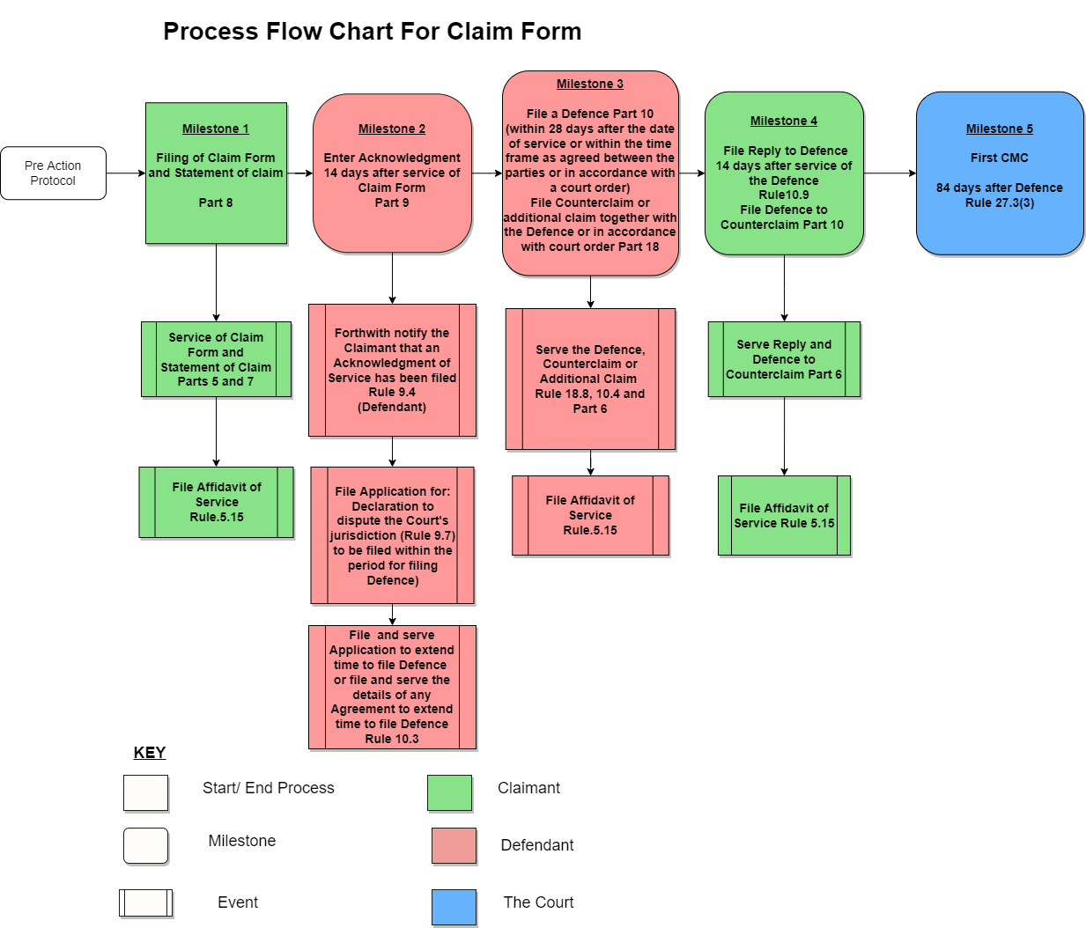

Slide 30
Standard Claim Form
A Spread Sheet
First CMC 84-140 Days after Service of Claim
Note that there might be factors known to court office that may have to be taken into account
Performance Measure
Court statistics should specify Percentage of First CMC to take place within 84-140 days

Slide 31
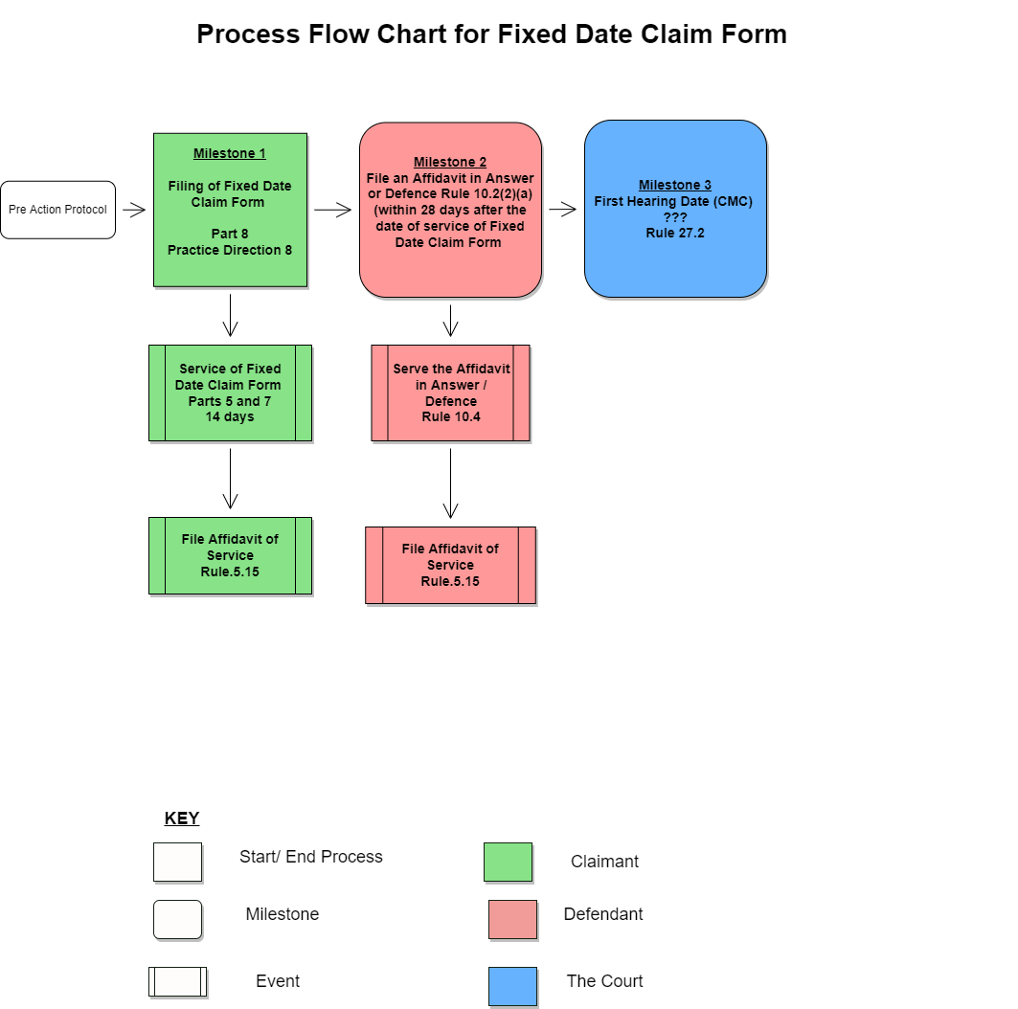

Slide 32
Fixed Date Claim Form
(Maximum Performance Standards)
How to calculate the first hearing date
Performance Standards
The claim is issued/filed zero day
Allow for service 14 days
Allow for defence 28 days
1st Hearing Date ??? (CMC)
NB Power of Court to schedule 1st Hearing to narrow issues and move towards disposal (27.2 (1),(2))
Percentage 1st Hearing within ??? Days
No Acknowledgment of Service xx%
Partial Admission of liability xx%
Total Admission of liability xx%
Trial at 1st Hearing xx%
Directions to narrow issues and move towards disposal xx%
(maybe the only relevant performance issue on this discussion is date of 1st Hearing, not what happens at it)

Slide 33
Fixed Date Claim Form
(ECSC Experience)
How to calculate the first hearing date
Performance Standards
The claim is issued/filed zero day
Allow for service 14 days
Allow for defence 28 days
1st Hearing Date 42 days (CMC)
NB Power of Court to schedule 1st Hearing to narrow issues and move towards disposal (27.2 (1), (2))
Percentage 1st Hearing within 42 Days
No Acknowledgment of Service xx%
Partial Admission of liability xx%
Total Admission of liability xx%
Trial at 1st Hearing xx%
Directions to narrow issues and move towards disposal xx%
(maybe the only relevant performance issue on this discussion is date of 1st Hearing, not what happens at it)

Slide 34
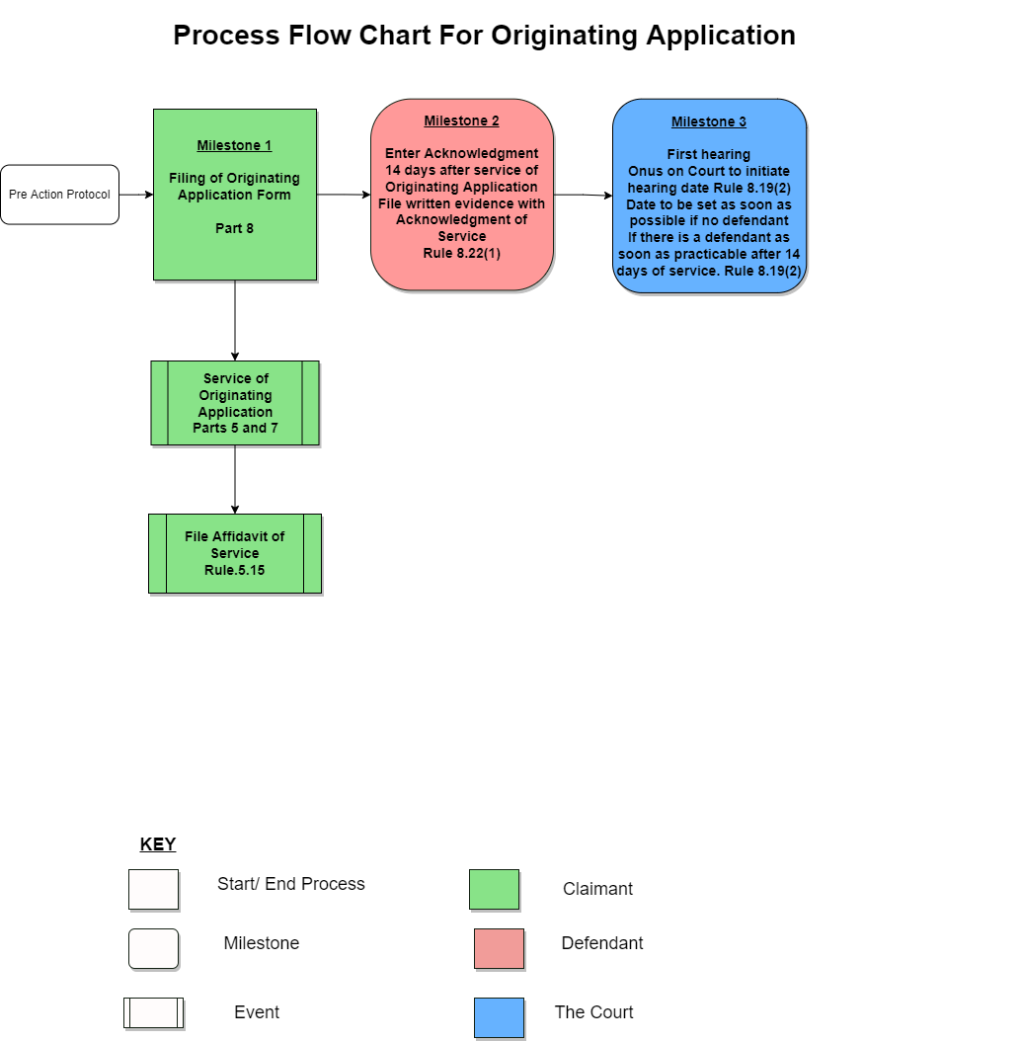

Slide 35
Originating Application
(service within Jurisdiction)
A Spread Sheet
From service to acknowledgement of service and defendant’s evidence 14 days (8.22(1)) – Zero Date
On filing court may fix a hearing date (8.19 (2))
Rules provide that written evidence to be submitted with acknowledgement of service (8.22(1))
onus on court to initiate hearing date (8.19(2))
A first hearing can take place:
  (a) if no defendant as soon as practicable after filing
  (b) if there is a defendant as soon as practicable after 14 days of service
Performance Measure
Percentage of first Hearings within XX days

Slide 36

Questions
Comments

Slide 37
Evidence Management

Slide 38
By the end of the session the participants will –
  Be able to locate evidence management in the context of: (i) the overriding objective, (ii) the court’s duty to manage cases, and (iii) the Court’s powers under the CPR;
  Learn about: (i) 5 overarching goals (ii) 6 reasons why evidence management is important, (iii) 5 points that underpin evidence management, and (iv) 5 principles that underpin disclosure;
  Be taken through a summary of the rules regarding evidence management and the 2 forms of disclosure under the CPR.

Slide 39

Evidence Management
Disclosure & Inspection (Part 28)
Evidence (Part 29)
5 OVERARCHING GOALS:
Giving Practical Effect to the Overriding Objective
Effectively and Efficiently Managing Cases
Pro-actively Exploring Possibilities for Settlement
Robust Preparations for Trial
Minimizing Costs and Reducing Delay

Slide 40

Why is Evidence Management Important?
6 Preliminary Reasons:
1. No matter how ‘good’ or ‘true’ a case may seem to be, facts need to be established and proved.
2. Admissible and relevant evidence is central to the integrity of the adjudicative process.
3. Judges and all parties have a responsibility to ensure that the best, most cogent, and most credible evidence is received by a court – to deal with cases justly.

Slide 41
Why is Evidence Management Important?
4. Evidence management depends on and supports issue identification.
Cases are issue driven and the relevance of evidence can only be determined after issues are clearly identified.
5. Effective evidence management prevents surprises, adjournments, delays,
and unforeseen and unbudgeted costs.
6. Effective evidence management promotes timeliness, certainty, fairness
and just depositions.
CAN YOU THINK OF OTHER REASONS?

Slide 42
General Considerations
A Case is Determined on Available and Admissible Evidence
5 Key Points:
Evidential issues to be Dealt with Justly – the Overriding Objective
Pro-actively Manage cases in relation to Evidential Matters
Use the Courts’ Powers to Effectively Receive and Use evidence
Apply Consequences to directions and orders
Explore/Apply the Most Expeditious, Least Costly options
EVIDENCE IS CENTRAL TO THE ADJUDICATIVE PROCESS
Notes:
No matter how ‘good’ a case may be, facts need to be established and proved.
Evidence is central to the adjudicative process.
Judges have a responsibility to ensure that the best, most cogent, and most credible evidence is received by a court – to deal with cases justly.

Slide 43
Part 1.1 Dealing with Cases Justly
1.1 The Overriding Objective
The overriding objective of these Rules is to enable the court to deal with cases justly and at proportionate cost.
(2) Dealing justly with a case includes, so far as is practicable:
(a) ensuring that the parties are on an equal footing;
(b) saving expense;
(c) dealing with the case in ways which are proportionate to
(i) the amount of money involved;
(ii) the importance of the case;
(iii) the complexity of the issues; and
(iv) the financial position of each party;
(d) ensuring that it is dealt with expeditiously and fairly;
(e) allotting to it an appropriate share of the court’s resources, while taking into account the need to allot resources to other cases; and
(f) enforcing compliance with rules, practice directions and orders.
Notes:
The OO is to be considered and applied in the interpretation and application of all aspects of the CPR.
Evidence management must be dealt with to ensure just disposition, fairness, expedition, and saving expenses.
Orders and directions must include provisions to enforce compliance.
Every case is to be treated as a project, and every intervention and action taken must advance a matter concretely and time based towards disposition – settlement, or judicial disposition.

Slide 44
Part 25.1 Duty to Pro-Actively Manage Cases
25.1 Court's duty actively to manage cases
The court must further the overriding objective by actively managing cases. This may include -
(a) identifying the issues at an early stage;
(g) deciding the order in which issues are to be resolved;
(j) ensuring that no party gains an unfair advantage by reason of that party’s failure to give full disclosure of all relevant facts prior to the trial or the hearing of any application;
(k) fixing timetables or otherwise controlling the progress of the case;
(l) giving directions to ensure that the trial of the case proceeds quickly and efficiently; and
(m) making appropriate use of technology.
Notes:
There is a positive duty, responsibility to pro-actively manage cases, and to do so effectively and efficiently.
Each case is to be treated as a project.
Evidence management is most effective and efficient when the issues are identified at the earliest stages of a matter.
Evidence must be relevant.
Relevance can only be ascertained when the issues are identified and prioritized.
Efficiency and effectiveness are achieved by the skilful use of fixed timelines, default consequences, and technology.
Expedition is a core value of the CPR.

Slide 45
Part 26 The Court’s Powers
26.1 Court's general powers of management
(1) The list of powers in this rule is in addition to any powers given to the court by any other rule, practice directions or any enactment
(2) Except where these rules provide otherwise, the court may –
(f) direct that any evidence be given in written form;
(k) extend or shorten the time for compliance with any rule, practice direction, order or direction of the court even if the application for an extension is made after the time for compliance has passed;
(m) hold a hearing and receive evidence by telephone or use any other method of direct oral communication;
(v) take any other step, give any other direction, or make any other order for the purpose of managing the case and furthering the overriding objective, …
Notes:
The court’s powers are wide – 26.1 (2) (v).
Time is malleable. Orders and directions should make use of this to ensure timeliness and efficiency in both Evidence Management and Case Management.
Evidence can be given in written form – and using this power to order that, say, witness statements, depositions, reports etc stand as evidence in chief should be routinely applied.

Slide 46
Part 26 The Court’s Powers
26.2 Court’s power to make orders of its own initiative
Except where a rule or other enactment provides otherwise, the court may exercise its powers on an application or of its own initiative.
26.7 The Court's powers in cases of failure to comply with rules, etc.
If the court makes an order or gives directions the court must whenever practicable also specify the consequences of failure to comply.
Notes:
The court can act on its own initiative and exercise its wide powers, and should do so when appropriate and in order to deal with cases justly.
All directions and orders should, as a general rule, SPECIFY CONSEQUENCES FOR DEFAULT.

Slide 47
Disclosure & Evidence
5 Key Principles:
Disclosure of all documents that are DIRECTLY RELEVANT must be encouraged and compelled at the earliest opportunities.
Pre action protocols, identification of documents in pleadings, and early consequential orders for standard disclosure promote just disposition, and the effective and efficient management of both evidence and cases.
Standard disclosure should be routinely ordered at the earliest opportunity and generally at the first CMC, or first hearing and be time bound, with specific default consequences applied.
There is a duty to disclose all documents and evidence that are directly relevant, and this duty is a continuous one.
Serious consequences can result as a consequence of default – e.g. non-reliance, striking out.
Notes:
Pre action protocols, and early consequential orders for standard disclosure promote just disposition, and the effective and efficiend management of both evidence and cases.

Slide 48
Part 28 Disclosure – General – Direct Relevance
28.1 Scope of this Part
(1) This Part sets out rules about the disclosure and inspection of documents.
(2) In this Part:
“document” means anything on or in which information of any description is recorded whether in writing, electronically or howsoever.
(3) A party “discloses” a document by revealing that the document exists or has existed.
(4) For the purposes of this part a document is “directly relevant” if -
(a) the party with control of the document intends to rely on it;
(b) it tends to adversely affect that party’s case; or
(c) it tends to support another party’s case,
but the rule of law known as “the rule in Peruvian Guano”* does not apply to make a document "directly relevant".
* “I desire to give as large an interpretation as I can to the words of the rule “a document relating to any matter in question in the action”. I think it is obvious from the use of these terms that the documents to be produced are not confined to those, which would be evidence either to prove or disprove any matter in question in the action. It seems to me that every document relates to the matter in question in the action, which would not only be evidence upon any issue, but also which, it is reasonable to suppose, contains information which may-not which must- either directly or indirectly enable the party requiring the affidavit either to advance his own case or to damage the case of his adversary.” Brett LJ, Peruvian Guano case, 4 (1882) 11 QBD 55.

Slide 49
Part 28 Disclosure – Scope – Who Had/Has Control
28.2 Duty of disclosure limited to documents which are or have been in party's control
(1) A party's duty to disclose documents is limited to documents which are or have been in the control of that party.
(2) For this purpose a party has or has had control of a document if -
(a) it is or was in the physical possession of the party;
(b) the party has or has had a right to inspect or take copies of it; or
(c) the party has or has had a right to possession of it.

Slide 50
Part 28 Disclosure – 2 Types – Standard & Specific
28.4 Standard disclosure – what documents are to be disclosed
If a party is required by any direction of the court to give standard disclosure that party must disclose all documents which are directly relevant to the matters in question in the proceedings.
28.5 Specific disclosure
An order for specific disclosure is an order that a party must do one or more of the following things –
(2) An order for specific disclosure may be made on or without an application.
(3) An application for specific disclosure is to be made on notice and unless in special circumstances at a case management conference.
(5) An order for specific disclosure may require disclosure only of documents which are directly relevant to one or more matters in issue in the proceedings.
Notes:
Both Standard and Specific disclosure require court orders or directions.
See also 28.12 (1): The duty of disclosure in accordance with any order for standard or specific disclosure continues until the proceedings are concluded.

Slide 51
Part 28 Disclosure – Criteria – Fairness/Costs
28.6 Criteria for ordering specific disclosure
(1) When deciding whether to make an order for specific disclosure, the court must consider whether specific disclosure is necessary in order to dispose fairly of the claim or to save costs.
(2) The court must have regard to-
(a) the likely benefits of specific disclosure;
(b) the likely cost of specific disclosure; and
(c) whether it is satisfied that the financial resources of the party against whom the order would be made are likely to be sufficient to enable that party to comply with any such order.
Notes:
Specific Disclosure – is it necessary, what are the benefits, costs.
Overriding Objective is linked to this.
A balancing discretionary exercise

Slide 52
Part 28 Disclosure – Duties – Attorneys/Parties
28.8 Duty of attorney
The attorney for a party must –
(a) explain to the maker of the list of documents the –
(i) necessity of making full disclosure in accordance with the terms of the order for disclosure and these Rules; and
(ii) possible consequences of failing to do so; and
(b) certify on the list of documents under rule 28.7(2) that the explanation required by sub-paragraph (a) has been given.
28.9 Requirement for maker to certify understanding of duty of disclosure
(1) The maker of the list of documents must certify in the list of documents that –
(a) the maker understands the duty of disclosure; and
(b) to the best of the knowledge of the maker the duty has been carried out.
(3) If it is impracticable for the maker of the list of documents to sign the certificate required by paragraph (1), it may be given by that person’s attorney.

Slide 53
Part 28 Disclosure – Duties - Continuous
28.12 Duty of disclosure continuous during proceedings
(1) The duty of disclosure in accordance with any order for standard or specific disclosure continues until the proceedings are concluded.
(2) If documents to which that duty extends come to a party's notice at any time during the proceedings, that party must immediately notify every other party and serve a supplemental list of those documents.

Slide 54
Part 28 Disclosure – Consequences - Serious
28.13 Consequence of failure to disclose documents under order for disclosure
(1) A party who fails to give disclosure by the date ordered or to permit inspection, may not rely on or produce at the trial any document not so disclosed or made available for inspection.
(2) A party seeking to enforce an order for disclosure may apply to the court for an order that the other party's statement of case or some part of it be struck out.
Notes:
Q What about continuous disclosure?
What are the consequences, if the duty arises after a date ordered for disclosure?

Slide 55
Part 28 Disclosure – Uses – Inspection/Copies - Admissions
28.16 Documents referred to in statements of case, etc.
(1) A party may inspect and copy a document mentioned in -
(a) an affidavit;
(b) an expert’s report;
(c) a statement of case;
(d) a witness statement or summary; or
(e) the claim form.
28.17 Subsequent use of disclosed documents
(1) A party to whom a document has been disclosed may use the document only for the purpose of the proceedings in which it is disclosed, unless –
28.18 Notice to prove a document Notice to prove a document
(1) A party shall be deemed to admit the authenticity of any document disclosed to that party under this Part unless that party serves notice that the documents must be proved at trial.

Slide 56
Part 29 Evidence – How Given - Court Controlled
29.1 Power of court to control evidence
The court may control the evidence to be given at any trial or hearing by giving appropriate directions, at a case management conference or by other means, as to the –
(a) issues on which it requires evidence; and
(b) way in which any matter is to be proved.
29.2 Evidence at trial – general rule
(1) The general rule is that any fact which needs to be proved by evidence of witnesses is to be proved at -
(a) trial, by their oral evidence given in public; and
(b) any other hearing, by affidavit.
(2) The general rule is subject to any -
(a) order of the court; and
(b) provision to the contrary contained in these Rules or elsewhere.
Notes:
Make orders for the use of witness statements, reports etc to stand as evidence in chief, subject to affirmation of truth and accuracy.

Slide 57
What Roles Will You Play?
As Judges …
As Attorneys …
As Court Administrators …
… and in relation to evidence management:
What roles are you required to play to further the objectives and achieve the performance standards of the CPR?
What are your KEY TAKEAWAYS?

Slide 58
Questions
Comments

Slide 59
Witness Statements

Slide 60
By the end of the session the participants will –
  Be able to locate witness statement within the context of the Overriding Objective;
  Be provided with a summary of the rules regarding production of evidence at trial and in particular the nature and content of a witness statement.

Slide 61
Production of Evidence- Witness Statements
Parts 29-31
How Evidence provisions (and witness statements) promote the Overriding Objective:
1. They eliminate surprise
2. They render the trial process more efficient and shorter
3. They render examinations-in-chief more about fairness and justice and less about memory contests and skilful advocacy
4. They enhance cross-examination which in our system is a vital aid to the pursuit of truth
5. They contribute to the fair and expeditious disposal of proceedings

Slide 62
Production of Evidence- Witness Statements
Parts 29-31
How Evidence provisions (and witness statements) promote the Overriding Objective
6. They save costs
7. They promote fair settlements and avoid some trials
8. They contribute to the identification of the real issues and elimination of unnecessary issues
9. They encourage admissions of fact
10. They reduce pre-trial applications
11. They concentrate parties on the real issues in dispute

Slide 63
General Rule Regarding Evidence
At trial, proof of facts must ordinarily be by oral evidence given in public; and
At any other hearing, by affidavit (Part 29.2)
General Rule subject to Orders of Court
  Court usually makes an Order that evidence be provided by witness statements and that
  Witness statements will stand as Evidence in Chief

Slide 64
Witness Statements
What is a Witness Statement?
  A statement of the evidence the witness wishes to adduce at trial
  Invariably ordered by the Court at the CMC to be served/exchanged
  Court invariably orders simultaneous exchange
  The witness statement must
    Be dated and signed with a certificate of truth
    Be in the words of the witness as far as practicable
    Sufficiently identify any document to which it refers
    Not include inadmissible matters

Slide 65
If you can’t get a signed WS by the time ordered?
Serve a witness summary instead i.e.
A summary, which must -
Certify the reasons why the WS could not be obtained
Provide, as far as possible, the likely evidence
Contain the name and address of the witness

Slide 66
You are ready to serve your WS but the other side is not?
You may file in a sealed envelope and give notice that you have filed
Court office must not disclose to the other side

Slide 67
Notes on Procedure at Trial
  WS usually treated as evidence in chief
  No WS within specified time? No evidence! (See Part 29.11). And court cannot give permission at the trial unless the party has a good reason for not previously seeking relief
  WS may be amplified by oral evidence at trial with court’s permission if
the WS had disclosed the substance of the evidence to be amplified
  New matters may be adduced orally only if court permits and the matters have arisen since service of WS

Slide 68
Notes on Procedure at Trial
  Court may give permission for witness to comment orally on opponent’s evidence
  Usually a trial is all about cross-examination and re-examination
  Court may also order in particular cases evidence to be given by Affidavit
(Part 30)

Slide 69
Notes: Evidence in Plans, Photographs etc
Intention to adduce such evidence must be disclosed
Latest date for disclosure is latest date for serving WS
If no order for WS disclose at least 21 days before hearing

Slide 70

Final Questions and Comments

Slide 71

Thank You

